Slide 1

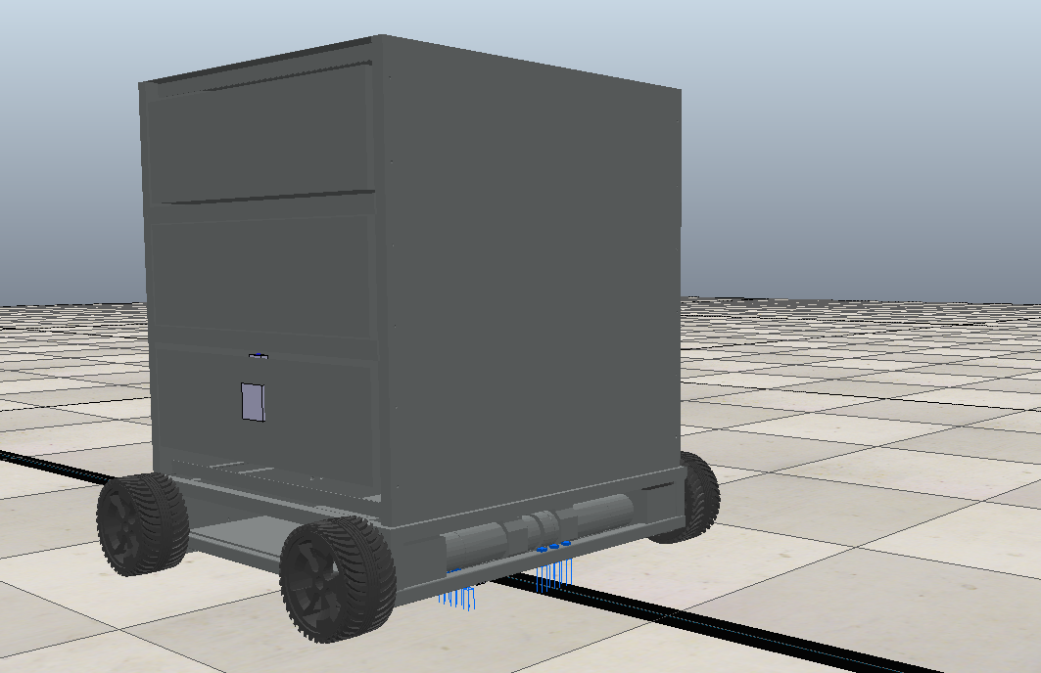
Bansilal Ramnath Agarwal Charitable Trust’s Vishwakarma Institute of Information Technology, Pune Department of Electronics and Telecommunications
Presentation:
Automated Guided Vehicle(AGV)
E&TC Dept.
Mayuresh Takawane
Shoaib Shaikh
Zahid Hussain
Guide:
Prof. Rahul Pol

Slide 2
Content
Sr No. | Title | Page No.
1 | Introduction | 3
2 | Objective | 4
3 | Methodology | 5
4 | Electronic Design and Layout | 7
5 | Cytron LSA08 | 8
6 | Communication | 10
7 | V-REP Simulation and Actual Implementation | 14
8 | Future Scope | 20
9 | References | 21

Slide 3
Introduction
An automated guided vehicle or automatic guided vehicle (AGV) is a mobile robot that follows markers or wires in the floor, or uses vision or lasers.
They are most often used in industrial applications to move materials around a manufacturing facility or a warehouse.
The IOT enables the communication between the AGV with the station, mobile application , central store and many more.
Thus AGV have various application when programed in such a way that it need to be.

Slide 4
Objective
The AGV following the line with identifying the stops marked on the ground.
Communicate with the Mobile Application to have the RFID strings.
Communicate with central store to get ready to carry the load.
Confirming the person with RFID tags and unlocking the drawers.
Return to the station for charging.

Slide 5
Methodology

Slide 6
START
Why Stopped?
Data
Base
Receive RFID Strings
Line Detection
Obstacle:
Wait Until path is clear
Station
Store Room
NO
Motor ON
YES
Obstacle Detection
Verify RFID
Charging
YES
Unlock Respective Drawer for particular time
NO
Stop
Detection
STOP
NO
YES
Lock The drawer
Motor OFF

Slide 7
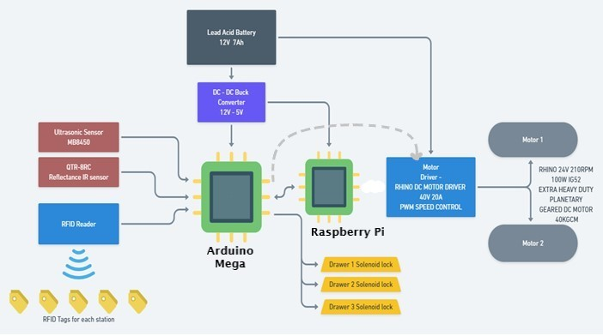
Electronic Design and Layout

Slide 8
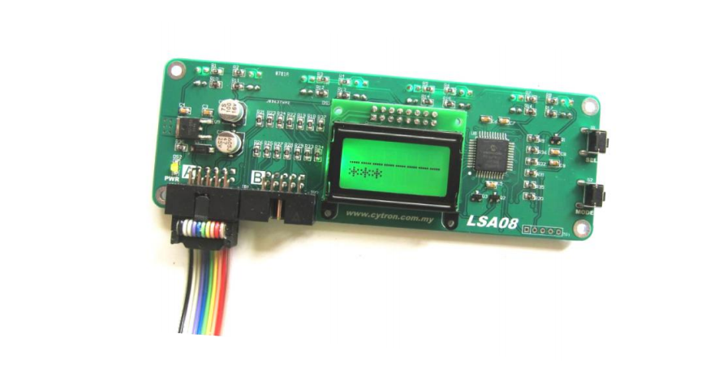
Cytron LSA08
Features:
Analog port and Digital port
Line Mode(Black/White)
J width
Baud Rate
Autocalibration
Junction Pulse

Slide 9
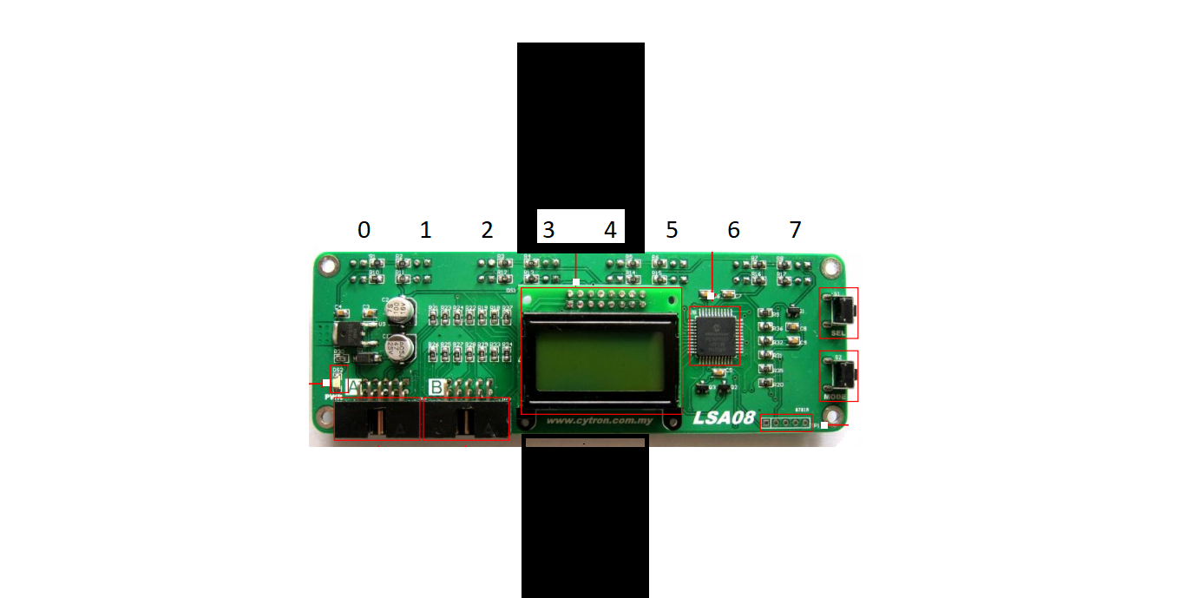
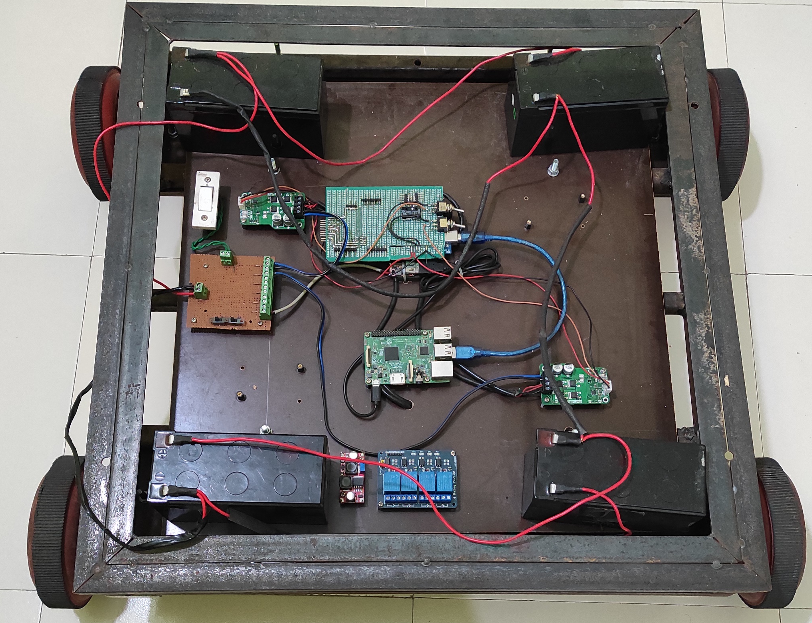
Working of Sensor and code…

Slide 10
Communication

Slide 11
MQTT
MQTT is a Client Server publish/subscribe messaging transport protocol.
It is lightweight, open, simple, and designed so as to be easy to implement.
These characteristics makes it use in Machine to Machine (M2M) and Internet of Things (IoT) contexts where a small code footprint is required and/or network bandwidth is at a premium.

Slide 12
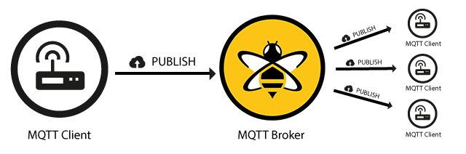
THE PUBLISH/SUBSCRIBE PATTERN

Slide 13
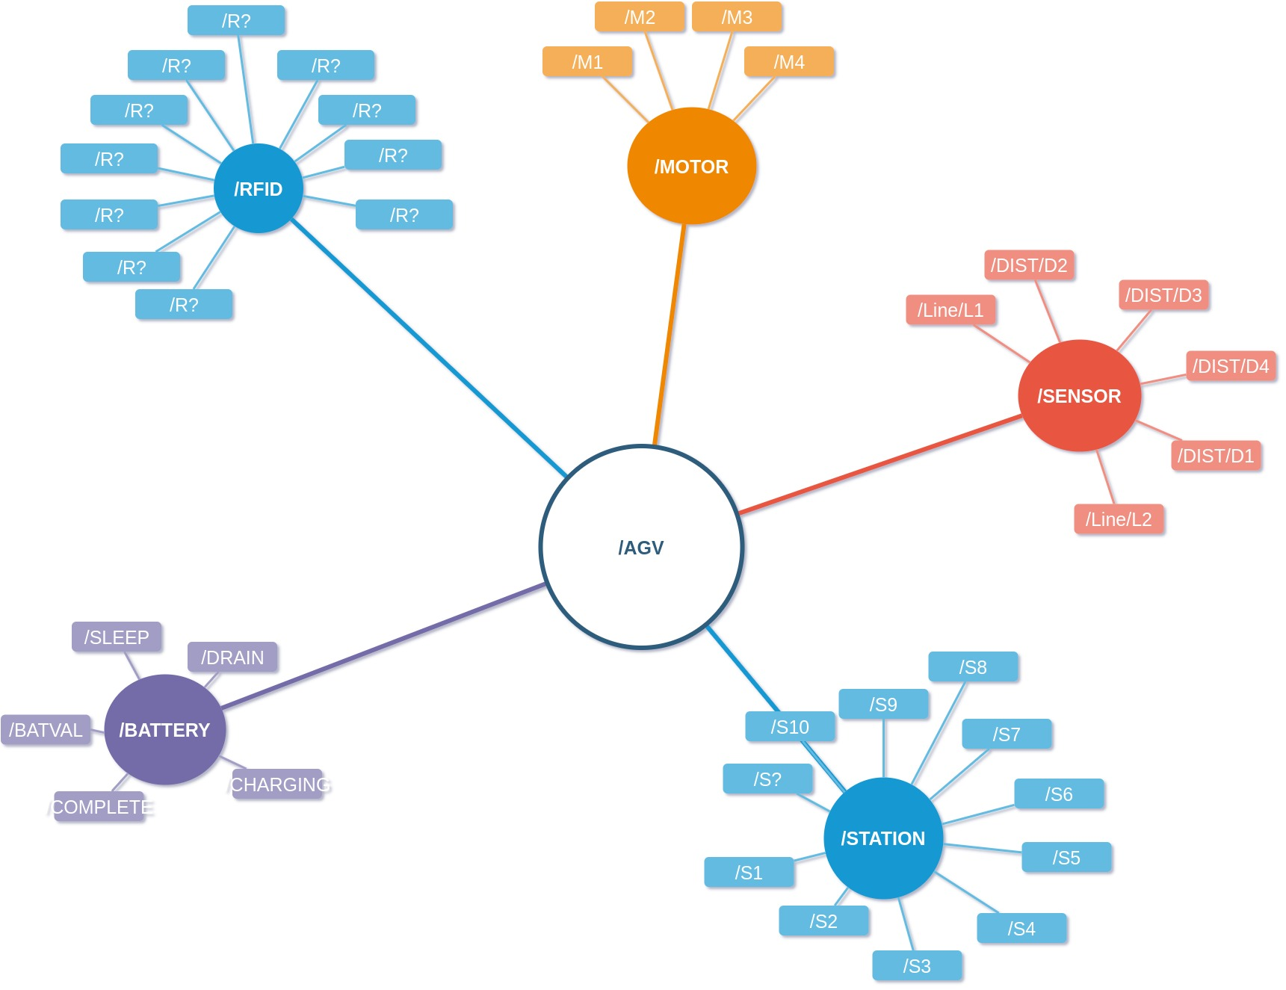
Message Tree

Slide 14
V-REP Simulation

Slide 15
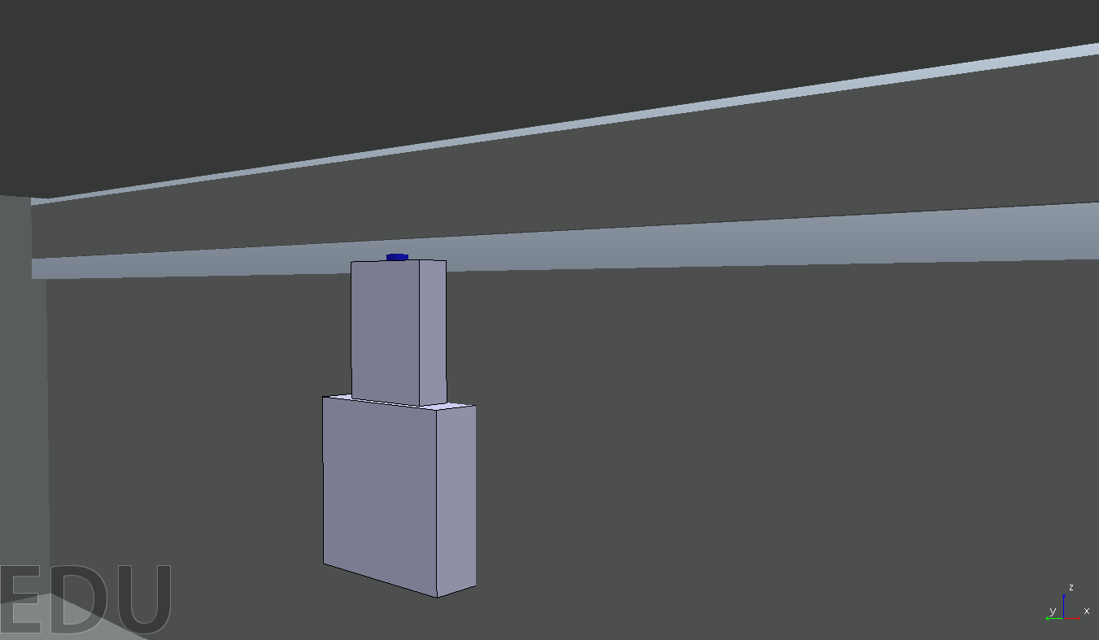
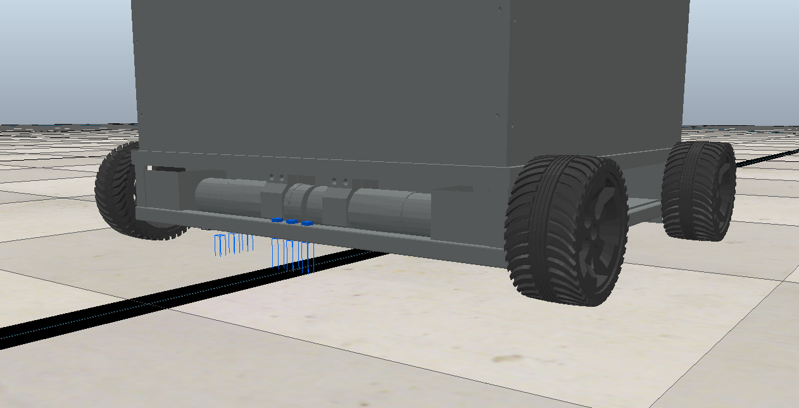

Slide 16
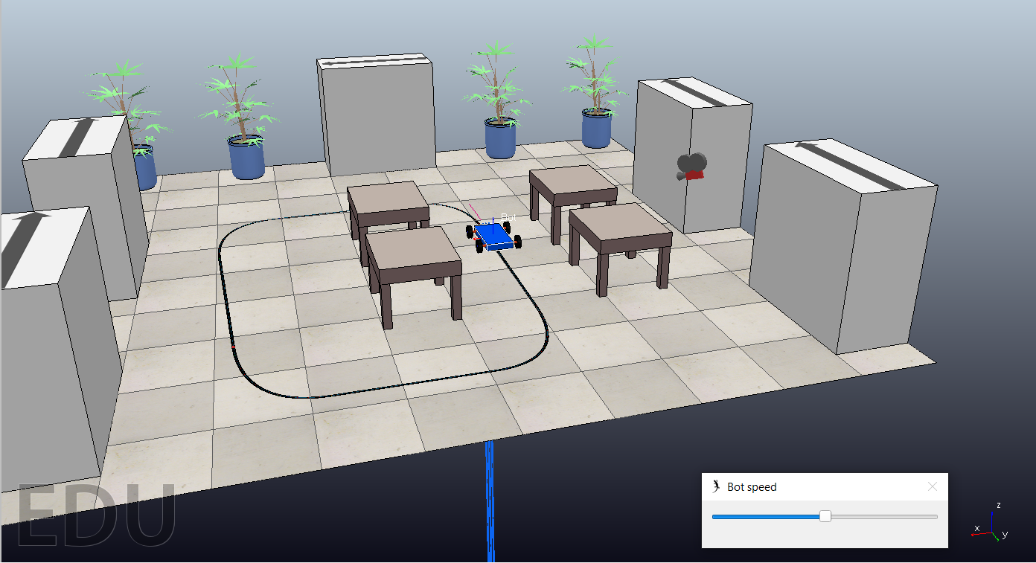

Slide 17
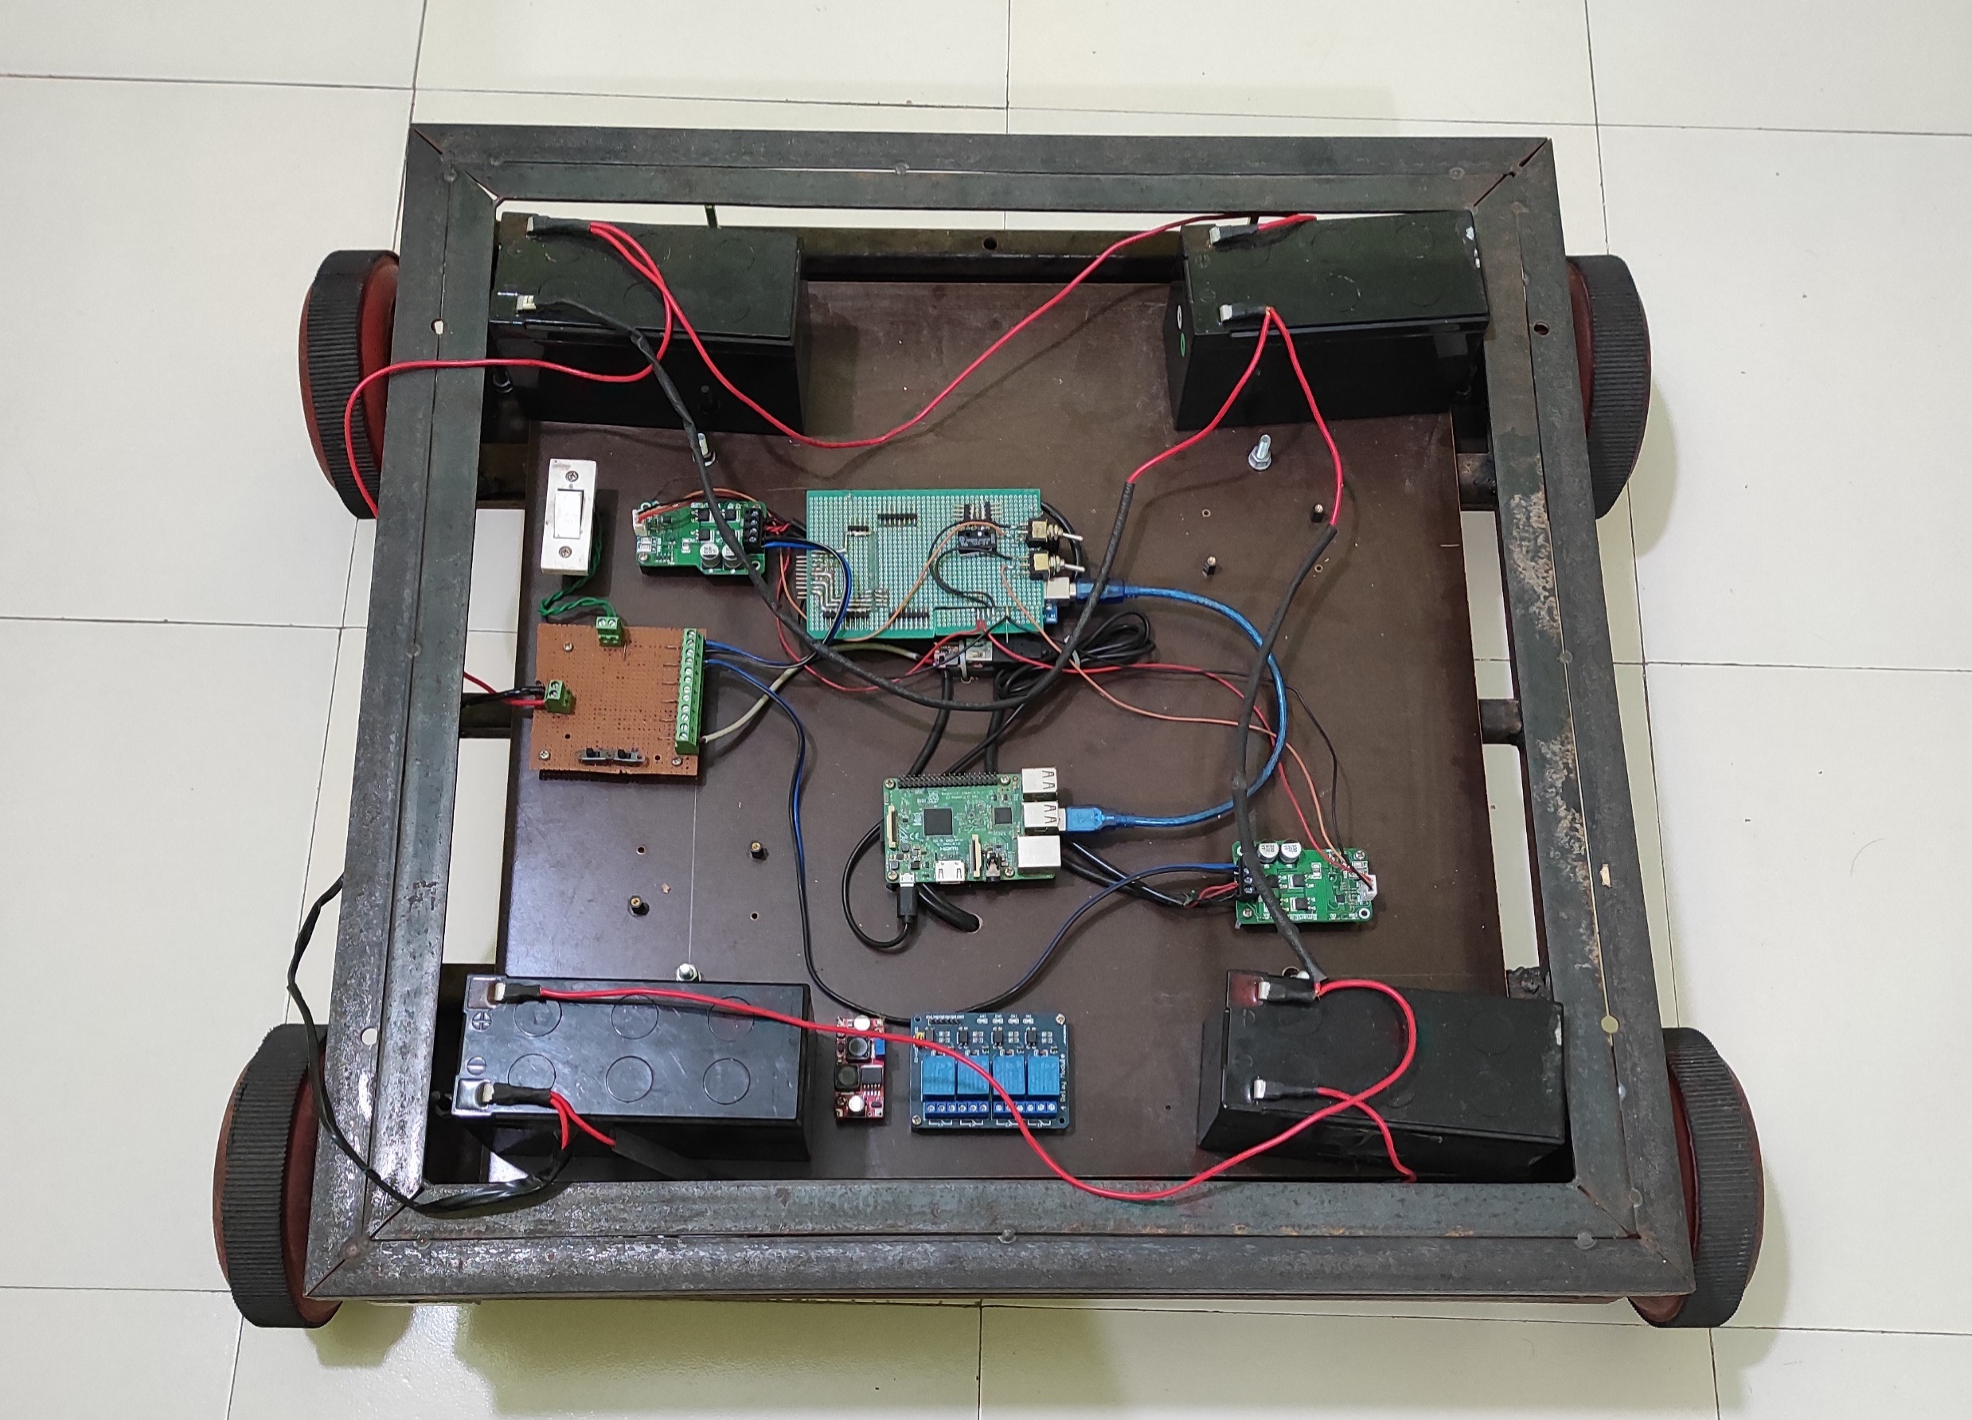
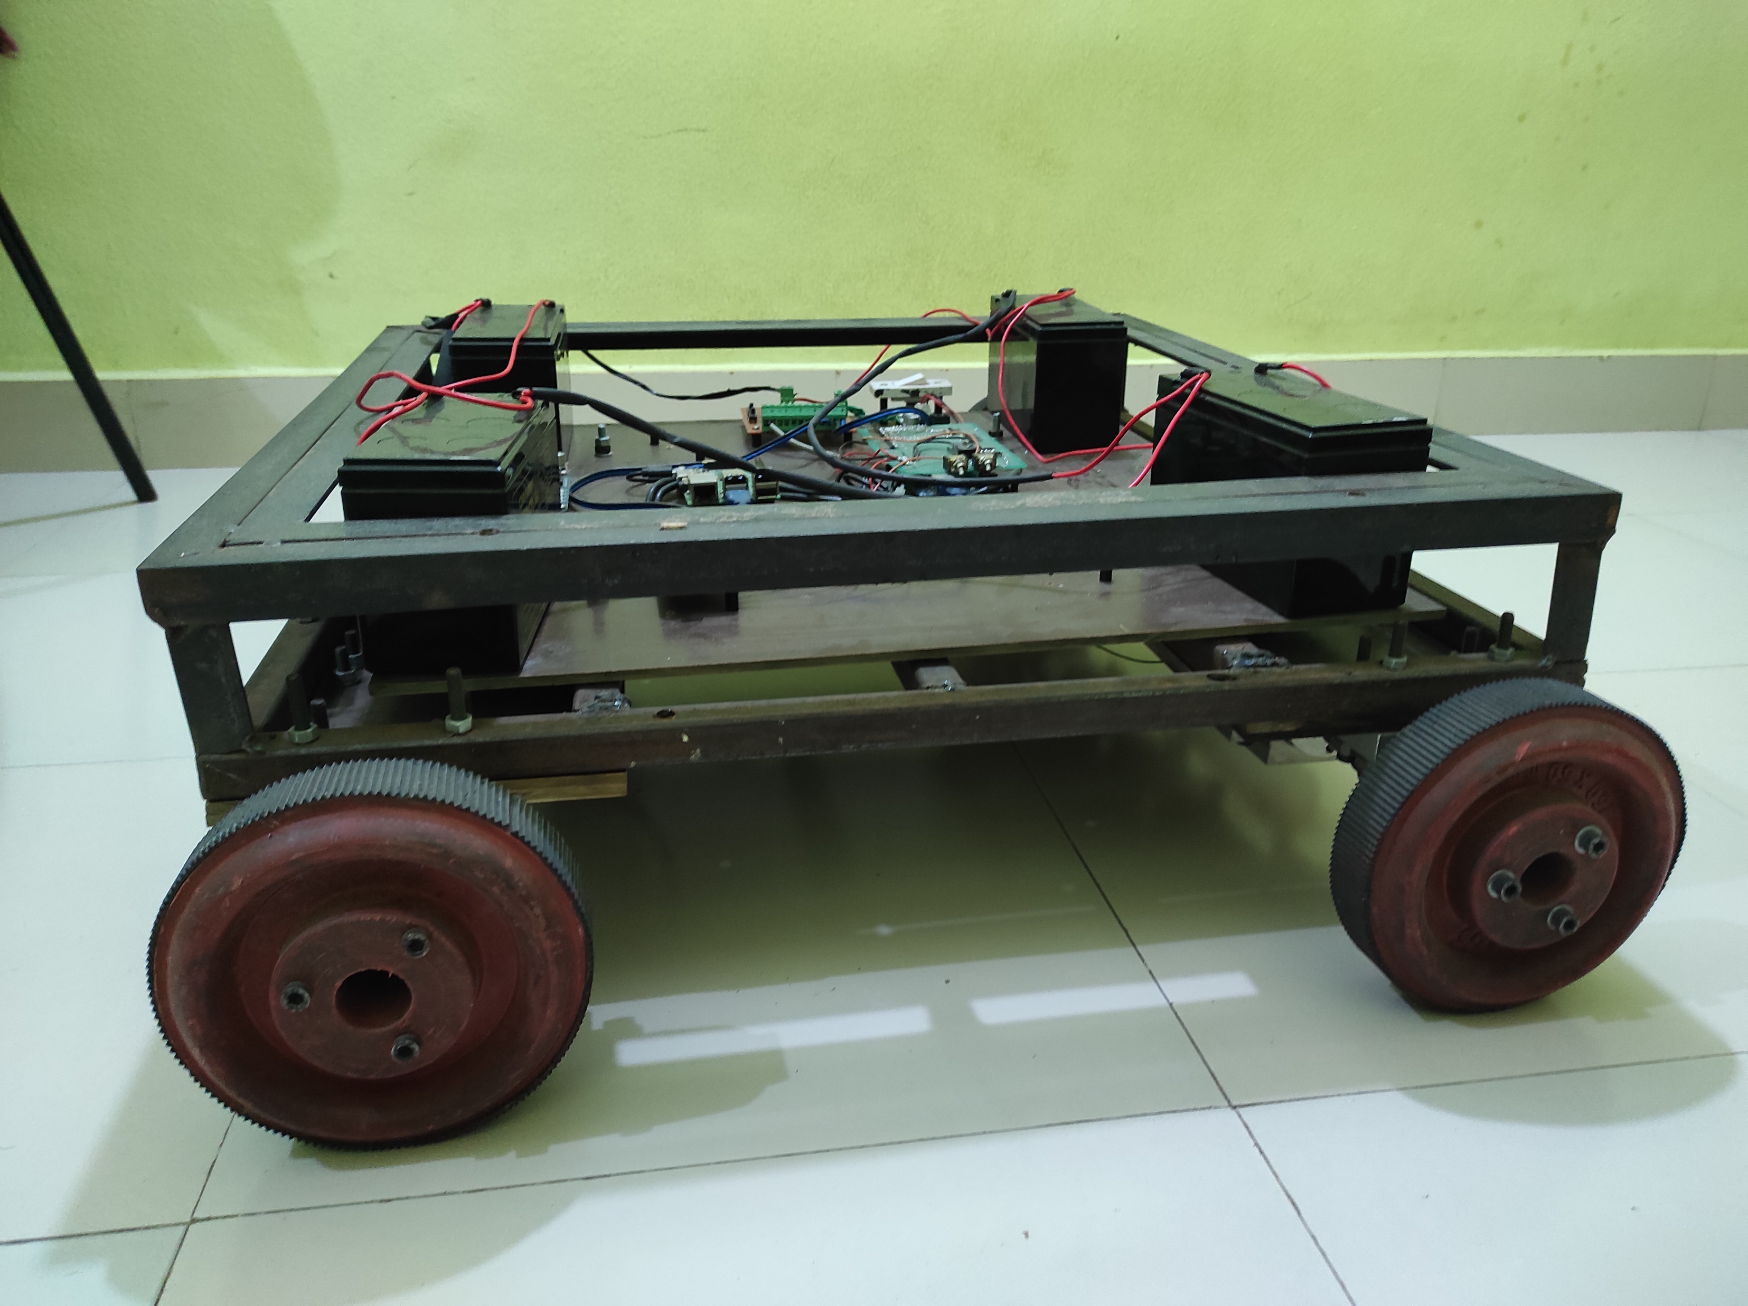
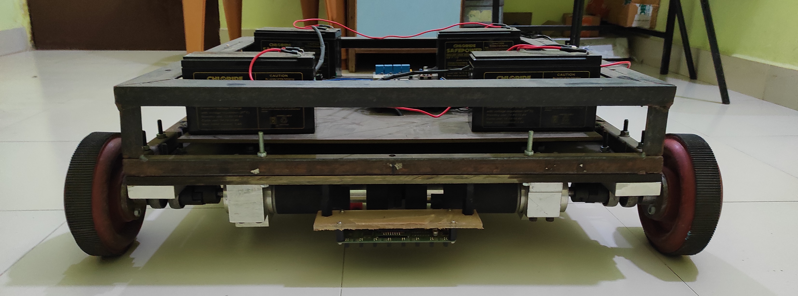
Actual Implementation

Slide 18
Videos...

Slide 19
Problems Faced…
Weight
Wheels
Not availability of Industrial Sensor

Slide 20
Solutions for problems…
Use of Caster wheel
Making of light weight chassis
Industrial sensor

Slide 21
Applications
Delivery of parts/tools in production line
Delivery of finished products
Waste management
Conveyor pick-up/Dropped facilities

Slide 22
References
https://www.coppeliarobotics.com
https://www.hivemq.com/blog/mqtt-essentials-part-1-introducing-mqtt/
Advanced Auto-Calibrating Line Sensor (cytron.io)

Slide 23
Thank you

